Slide 1
Session 9
Introduction to Heroku

Slide 2
Heroku is
An elastic multi-language multi-framework Platform as a Service

Slide 3
Heroku is
Heroku as part of the Salesforce Platform

Slide 4

Heroku first class languages
Ruby, Node (JavaScript), Python & Java

Slide 5

Heroku gives you…
Developer driven deployment
Deploy using Git version control, the most popular tool for
developers

Slide 6
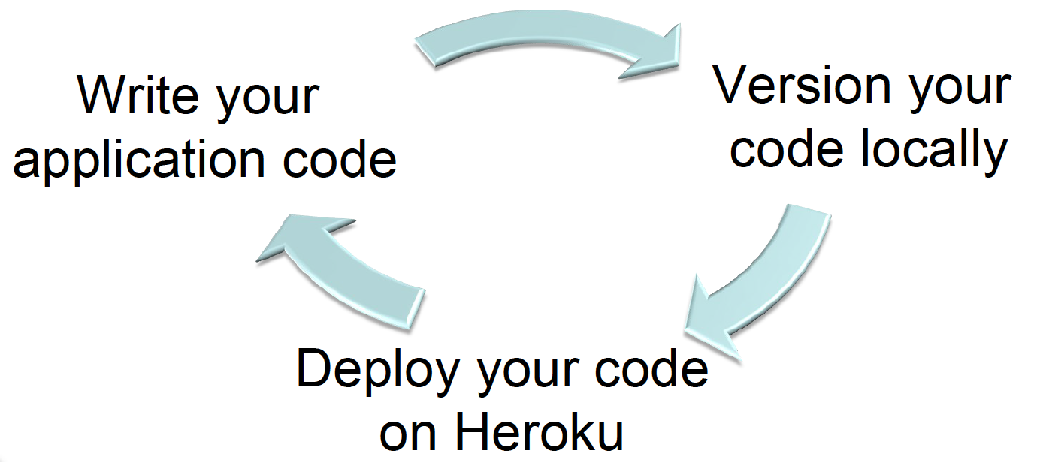
Heroku gives you…
Instant & continuous deployment

Slide 7
Heroku gives you…
Repeatable & traceable deployment
Code commits drive application releases
Easily manage versions across multiple environments (dev, test, staging, production)

Slide 8
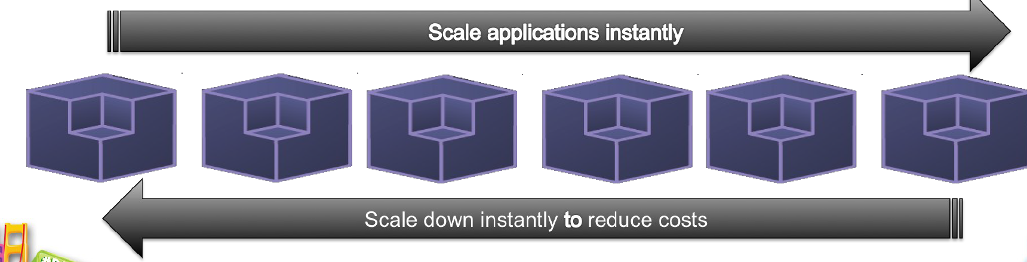
Heroku gives you…
Elastic scaling of your applications
Instantly deploy your app over multiple Dynos
Scale down during quite periods to save costs

Slide 9
Hosting a PHP website on Heroku
1. Create a repo on Github
2. Populate the content
3. Config Heroku with Github

Slide 10
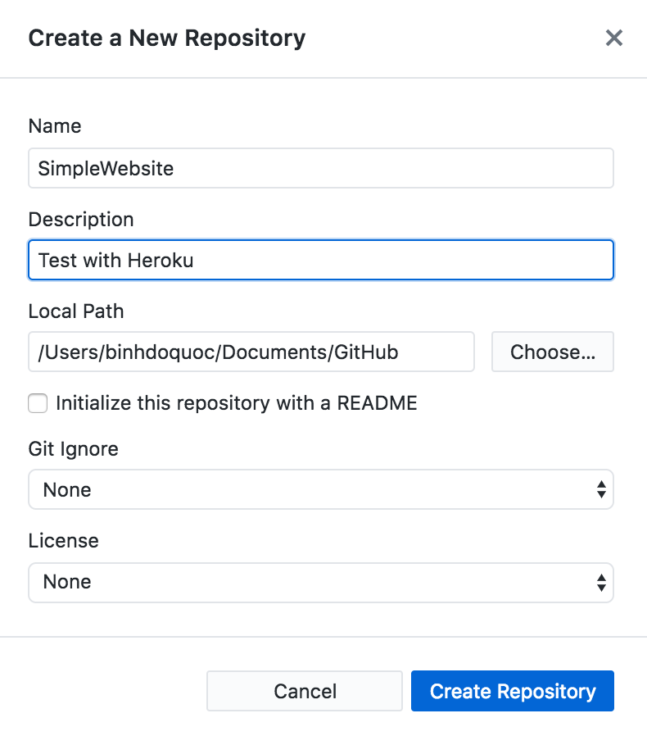
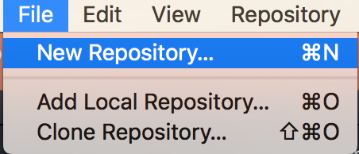

Create a repo on Github
Click here to open local folder

Slide 11
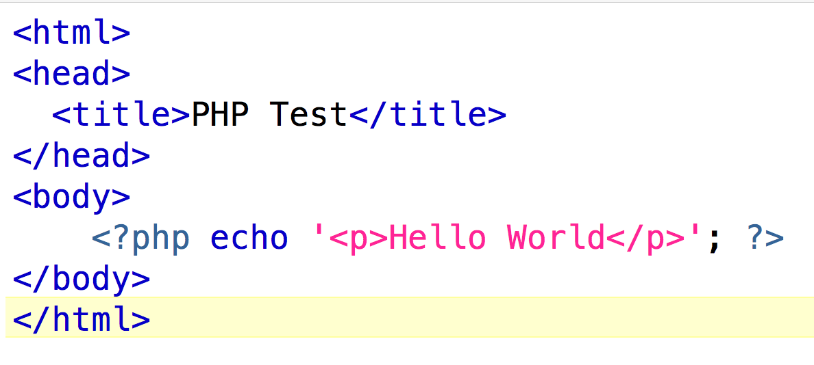
Populate content
Inside the current repo which created in the previous step create a PHP file with content like this

Slide 12
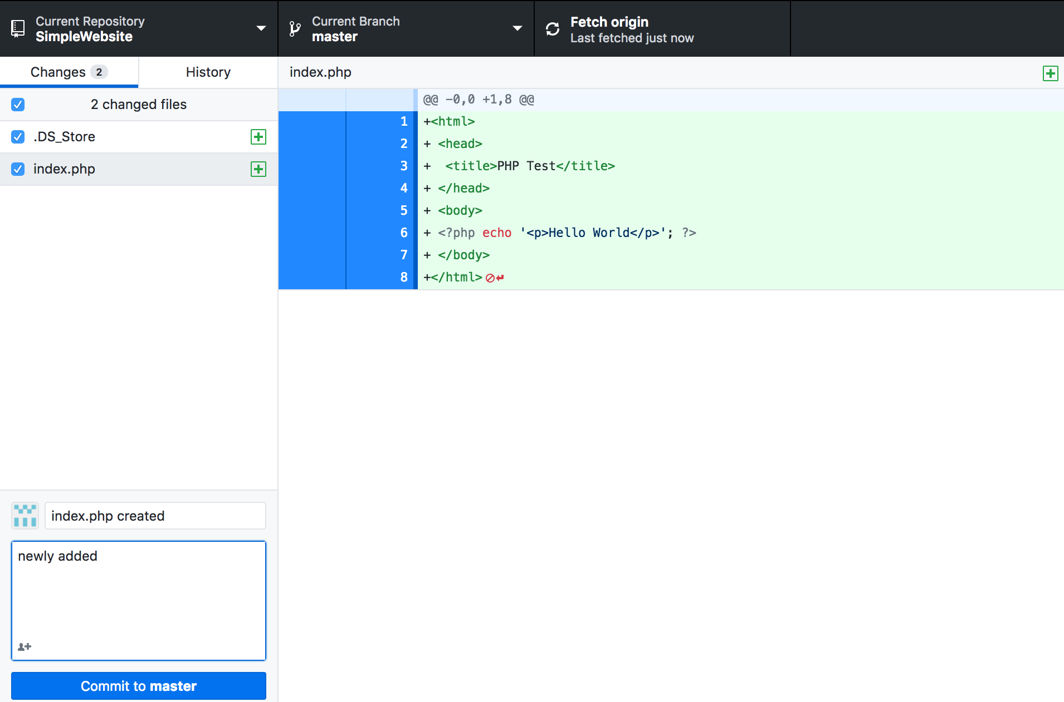
Enter comment here
Click Commit
Click Fetch origin

Slide 13
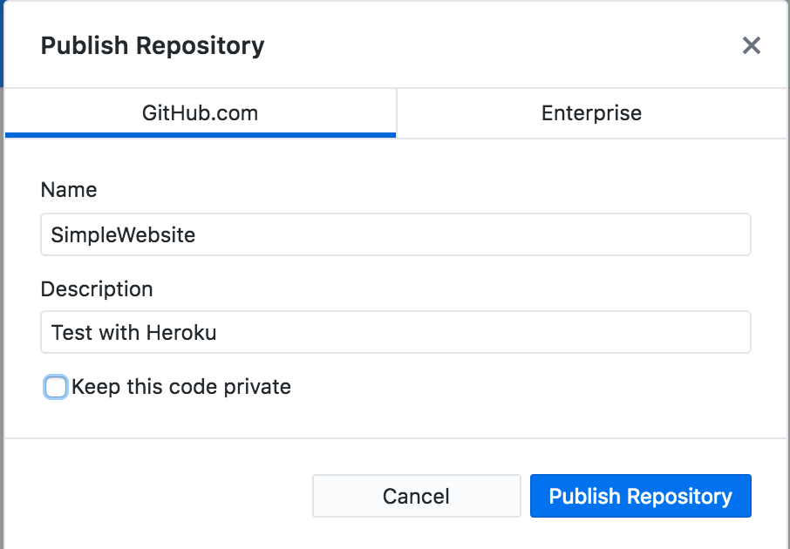
Click this button to publish the local to Git

Slide 14
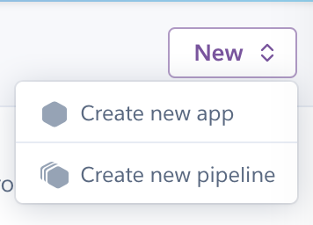
Config Heroku to Github
On Heroku Dashboard click New then Create new app

Slide 15
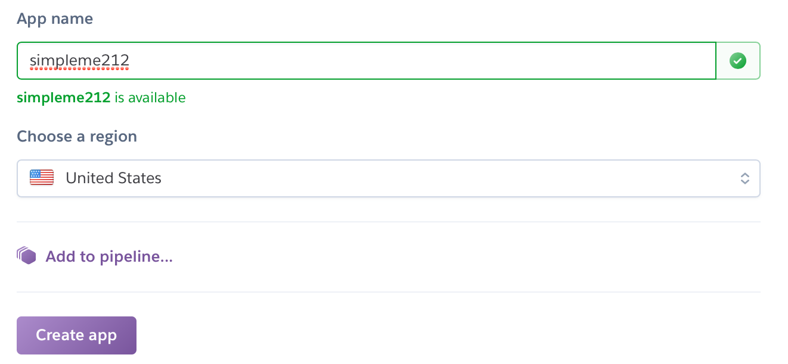

Slide 16
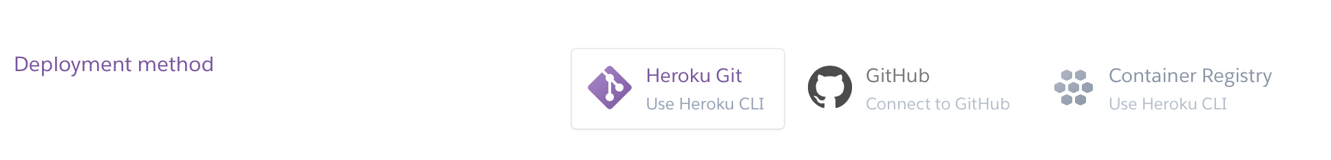
Select GitHub then Enter your login credential

Slide 17
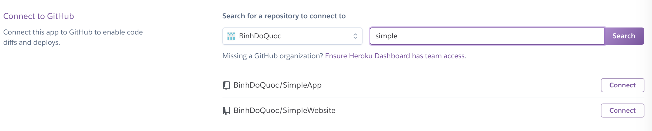
2. Select this
1.Enter Repo name and hit Search

Slide 18
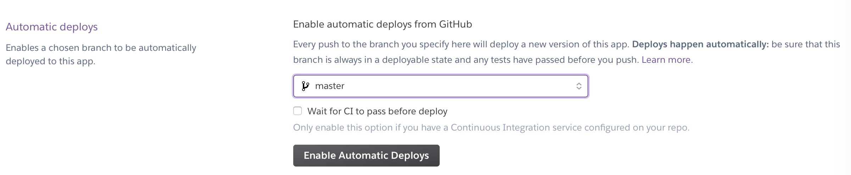
Config Heroku to Github
Select this

Slide 19
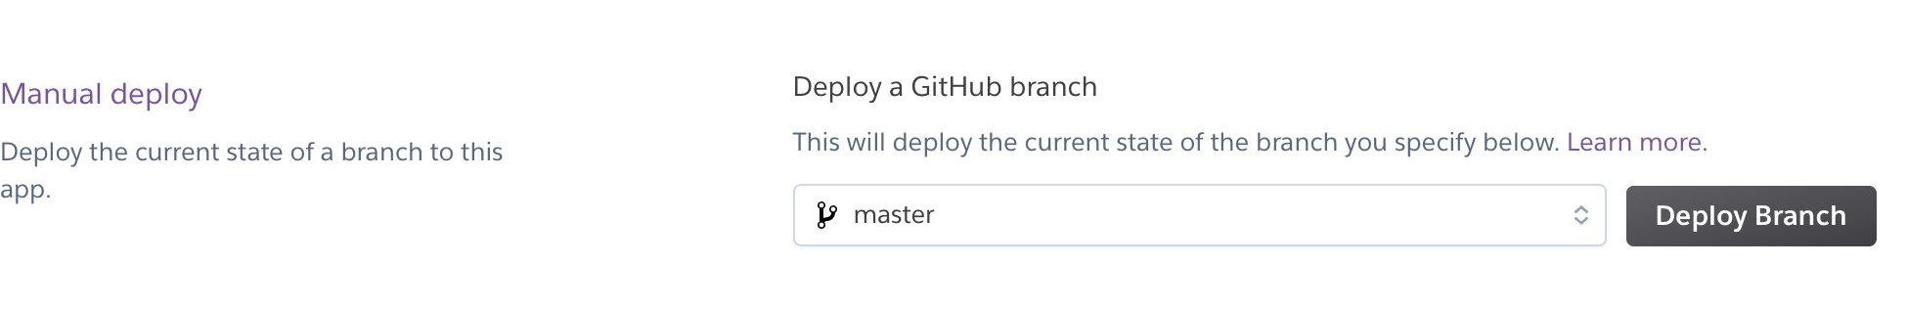
Select this

Slide 20
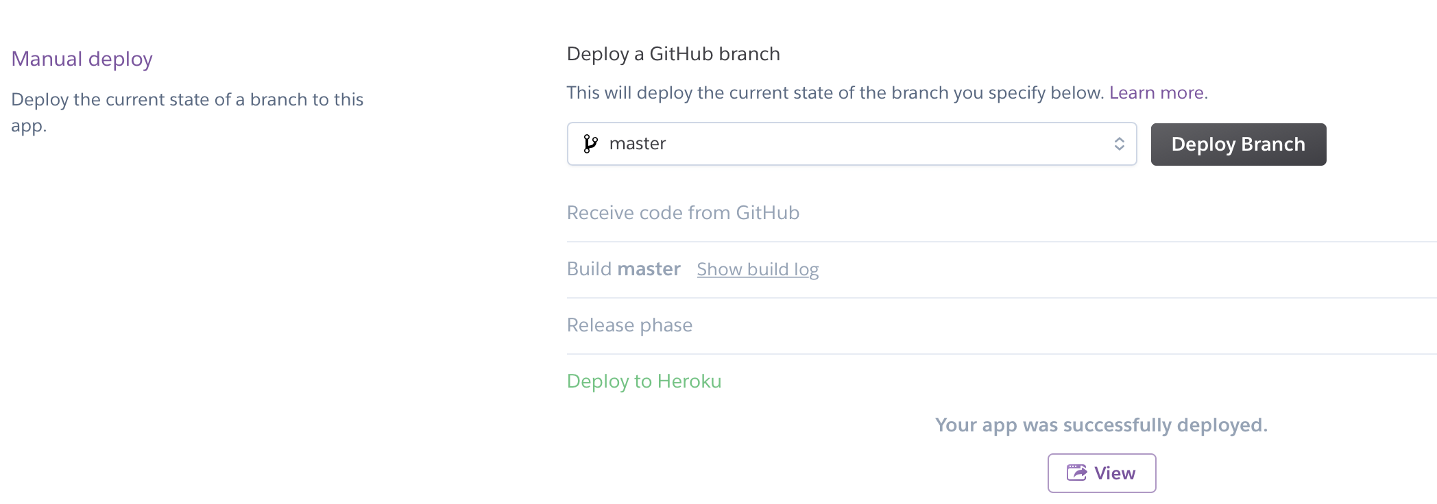
Deployed successfully
Click here to view the website

Slide 21
Exercise
Make a change in Index.php file and deploy the changes on Heroku

